Slide 1




Waterfall vs Agile: Methodologies Compared
The Waterfall and Agile methodologies are two widely used approaches to software development, each with its own advantages and disadvantages. Understanding the key differences between these methodologies is crucial when selecting the right approach for your project.
by Manish

Slide 2
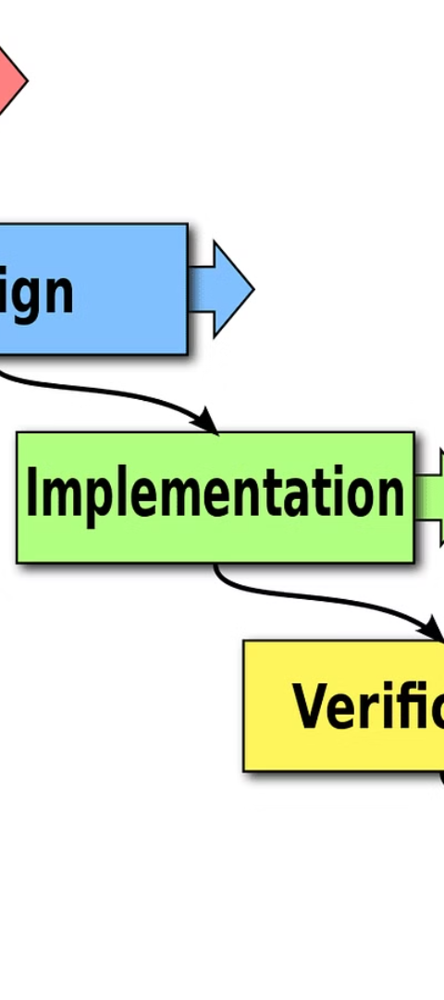
Waterfall Methodology: An Overview
1
Requirements
Gather and define project requirements upfront.
2
Design
Develop a detailed design plan before any coding begins.
3
Implementation
Implement the design in a linear, sequential manner.

Slide 3
Agile Methodology: An Overview
Planning
Review
Identify a product backlog and plan work in short, iterative sprints.
Continuously review and improve the product through each sprint cycle.
1
2
3
Development
Complete work in small, incremental steps with frequent feedback and adaptation.

Slide 4
Advantages of Waterfall Methodology
Predictability
Simplicity
Documentation
The linear, sequential nature of Waterfall provides clear visibility into project timelines and deliverables.
Waterfall follows a straightforward, well-defined process that is easy to understand and manage.
Extensive documentation is generated throughout the Waterfall process, providing a clear record of the project.

Slide 5
Disadvantages of Waterfall Methodology
1
Inflexibility
2
Delayed Feedback
Changes to requirements or design are difficult and costly to implement in Waterfall.
Customers don't see the final product until the end, leading to potential misalignment.
3
Long Timelines
4
Risk of Failure
The sequential nature of Waterfall can result in long development cycles before any functionality is delivered.
If requirements are not fully defined upfront, the entire project is at risk of failure.

Slide 6
Advantages of Agile Methodology
Flexibility
Early Delivery
Agile allows for quick adaptation to changing requirements and market conditions.
Agile's iterative approach enables the delivery of working software at regular intervals.
Collaboration
Continuous Improvement
Agile promotes close collaboration between cross-functional teams and stakeholders.
Agile's iterative nature allows for ongoing refinement and enhancement of the product.

Slide 7




Disadvantages of Agile Methodology
Time Pressure
Limited Documentation
Lack of Oversight
Scope Creep
The rapid sprint cycles of Agile can create a sense of constant pressure and stress.
The decentralized nature of Agile can make it challenging to maintain overall project visibility and control.
The flexible nature of Agile can lead to constantly shifting requirements and scope.
Agile's focus on working software over comprehensive documentation can lead to knowledge gaps.

Slide 8
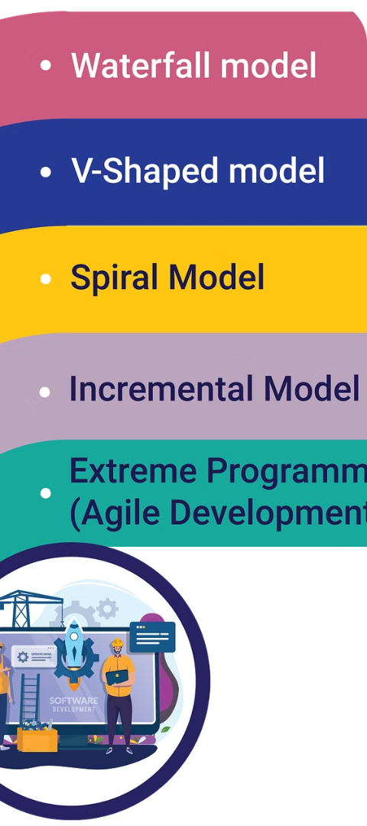



Choosing the Right Methodology
Project Requirements
Evaluate the project's specific needs, such as complexity, timeline, and stakeholder involvement.
Team Composition
Consider the skills, experience, and collaboration dynamics of the development team.
Organizational Culture
Align the chosen methodology with the organization's values, processes, and management style.
By carefully considering these factors, you can select the most appropriate methodology to ensure the success of your software development project.

